Slide 1
User Auditing but Saucy

Slide 2
What do you recall?
1
Please don’t disappoint me D:
Notes:
Ask them: What is user auditing? What is an admin? What is a user? What are groups? What are privileges and control access?
Just compliment them or criticize them after they do their schpeel cuz you will review these later in the slides.

Slide 3
Users and Groups
Users:
(general definition) people who access a computer and are given certain privileges so that they can access files, setting, etc.
(technical definition) a mechanism that runs processes on the computer to modify the environment
Ex: system users
Three types: general, root, system
General: your average Joe using a computer
Root: The Omnipotent One; has access to all
System: background process runners; programs will run using these
Groups: users are allotted in these, many of the times to allow permissions and privileges
Notable one is sudo (group #27 in /etc/group)
If you made a server, the server will make a group that gives user in it access
** Thinking in the perspective of an attacker **
[If I am part of a group with special privileges like sudo or be one with root, I can take and destroy all the data if I want to. Kekekekeke]
They will also find nooks and crannies (any user) to make things go their way
What is this you ask?...
Notes:
For explaining the technical definition, tell them that system users often keep programs running, ie lightdm sys user continues running scripts so that you don’t have to stare at a terminal for an eternity

Slide 4
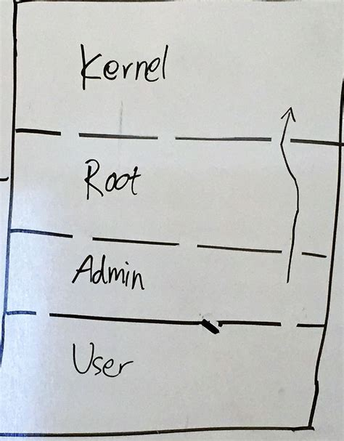
Privilege Escalation
PrivEsc for short
This is the method that attackers hijack your system
Notes:
Tell them this will be explained later in the lab

Slide 5


How do I stop this?
Look for any users that aren’t necessary and delete them
Can run some scripts (LinEnum.sh) to find vectors if still there
Change user privileges by adding/removing them from groups
May run sudo or other powerful cmds
Quality password hygiene (getting into later)
Will try to bruteforce/dictionary attack
Prevent login for root or guest
These will make hacker scratch the dandruff off their heads and make them spend more time trying to bruteforce.
Notes:
LinEnum hunts down vulnerable access points for the attack so that he/she can take advantage

Slide 6
The CMDs and Files
Add/Remove Users:
adduser/deluser [user] OR
useradd/userdel [user]
user__ is low utility
__user requires more info
/etc/passwd: add/remove lines to add/remove users
Rule of thumb: sys users have UID < 1000, reg users have UID >= 1000
Add/Remove Groups:
addgroup/delgroup [group] OR groupadd/groupdel [group]
Same shenanigans w/ user audit CMDs
Add/Remove Users from Groups:
usermod -aG [group] [user]
gpasswd -d [user] [group]
/etc/group:
add/remove lines to remove groups
add/remove usernames from lines to add/remove users from groups
Show groups: groups [user]
Notes:
Hidden users can look like sys users w/ their UID
Can find UID ranges in /etc/login.defs
If #’s change so that there are more sys users, fix it back (sys users/hidden ones get more privileges that way)

Slide 7
Two More User Auditing Things
Delete Guest Session on LightDM
Guest account can only be seen through the display manager
Depends on what flavor/version of Ubuntu that you use
Ubu14: make sure [SeatDefaults] or [Seat:*] exists and type in allow-guest=false into /etc/lightdm/lightdm.conf
Ubu16: make a file called 50-no-guest.conf in LightDM config folder
Debian runs on GDM, no guest account here
Locking Root
passwd -l root
passwd usually deals w/ editing passwords, but we’ll get into that later

Slide 8
In conclusion
Keep your users safe from the online attackers :D
Notes:
The lab for today is going to teach them some privesc techniques so that they have a better understanding of how vulnerable they can be if they don’t practice/apply their cyber knowledge

